Slide 1
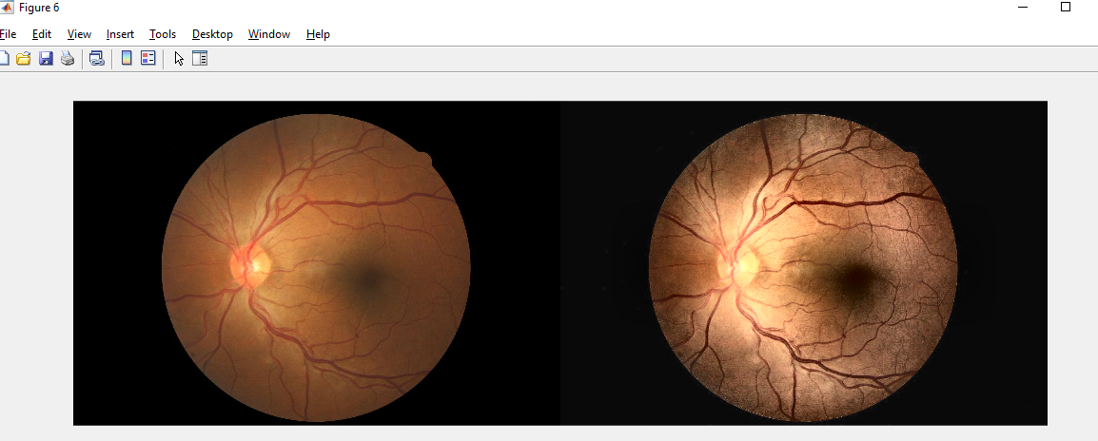


Smart Phone Based Detection of Retinal Abnormalities
Dr. Syed Saud Naqvi, Associate Professor / Dr. Haroon Ahmed Khan, Assistant Professor
Department of Electrical & Computer Engineering, CUI, Islamabad Campus
Abstract:
Eye diseases can cause image loss
Early diagnosis can save eyesight
Fundus (Retinal Images) are needed for diagnosis
Acquiring fundus images and getting specialist diagnosis can be:
Expensive
Difficult
Unavailable (to a large population)
We are developing a component of a mobile application for the diagnosis diabetic retinopathy (DR), a very common eye disease.
Block Diagram
Methodology:
Capture fundus image
Uses a 2-stage CNN networks with Transformers for accurate classification:
Retinal vs non-retinal image
Identification of DR
Integrate model for inference on an Android smartphone
Output
Recognition
Smart Phone
Diagnosis
DR
Application
Grading
Smart Phone Camera/Gallery
Retinal Image
Flow Chart
Results & Discussion:
Android/Web app identifies image as retinal / non-retinal
Determines presence of DR
Presents progression of disease
Accuracy 85%
Image Acquisition
Server
Retinal/Non-Retinal
If retinal?
False (Non-Retinal)
Image
Network
Model 1
Problem Statement:
Current equipment to capture fundus images for DR Diagnosis is expensive and not widely available
Many people in Pakistan do not have access to eye hospitals, doctors, specialists etc.
Eye specialists are expensive
Application
True (Retinal)
Outcome
Conclusion:
This project addresses challenges in diagnosing and treating DR.
It proposes a smartphone-based DR detection system using deep learning.
It offers an automatic diagnosis tool, reducing reliance on expensive equipment and specialist consultation.
It improves healthcare accessibility and encourages early intervention.
Immense future potential of value addition
Server
Image
Network
Model 2
Referable/Non-Referable
Process Flow Diagram
Image Acquisition
DR Grading
Image Preprocessing
Model Training
Analysis
Objective:
We want to contribute to the development of a smartphone-based retinal imaging and diagnostic system that is able detect and diagnose DR
Noise Removal
Model Training
Accuracy
Resize
Model Testing
Specificity
Augmentation
Model Compression
Sensitivity
Department of Electrical & Computer Engineering.
COMSATS University Islamabad.
Submitted by:
Rohaid Ahmed Mirza FA19-BCE-006
Shakir Khan FA19-BCE-008
M Zain Zubair Pirzada FA19-BCE-027
.

